Slide 1
Arabic in Space
Gilad Schreiber

Slide 2
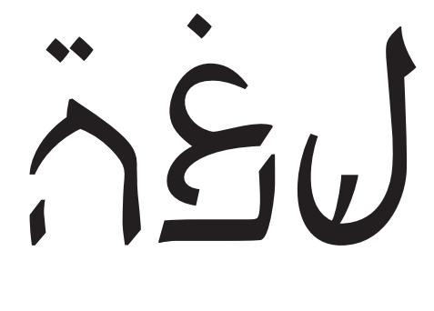
Motivation
The Arabic language in the eyes of Hebrew speakers may be unpleasant and even frightening
But maybe we can look at it in different perspective.

Slide 3
Sonification approach
Demonstrate the ratio between Hebrew speakers and Arabic speakers along Israel in two different perspectives.
The choice is in your hands!

